Slide 1






Incredible

Slide 2

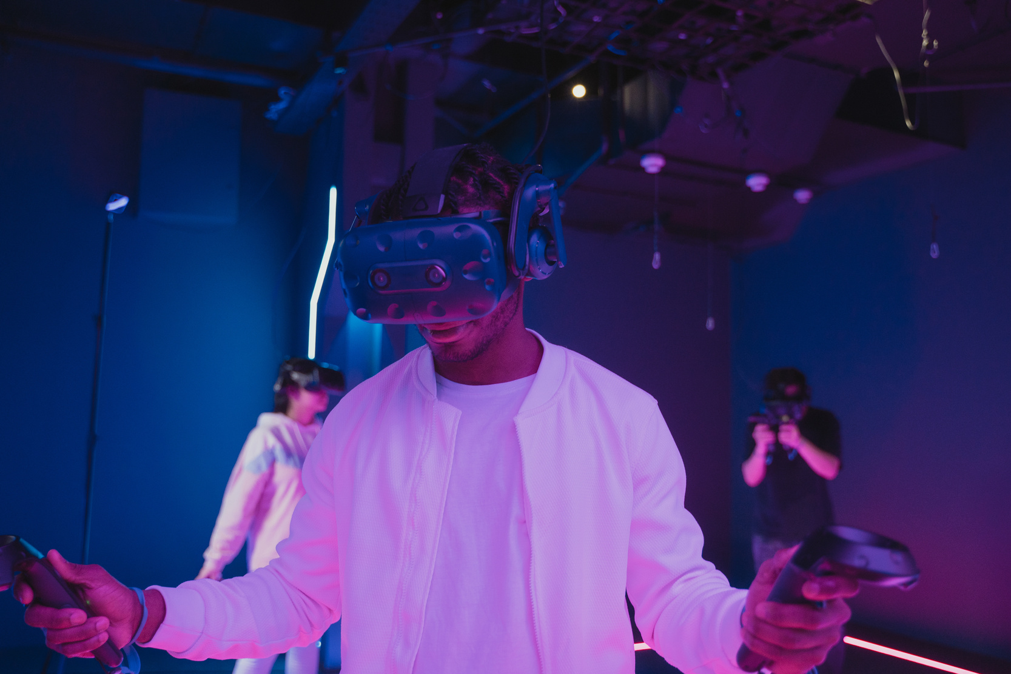
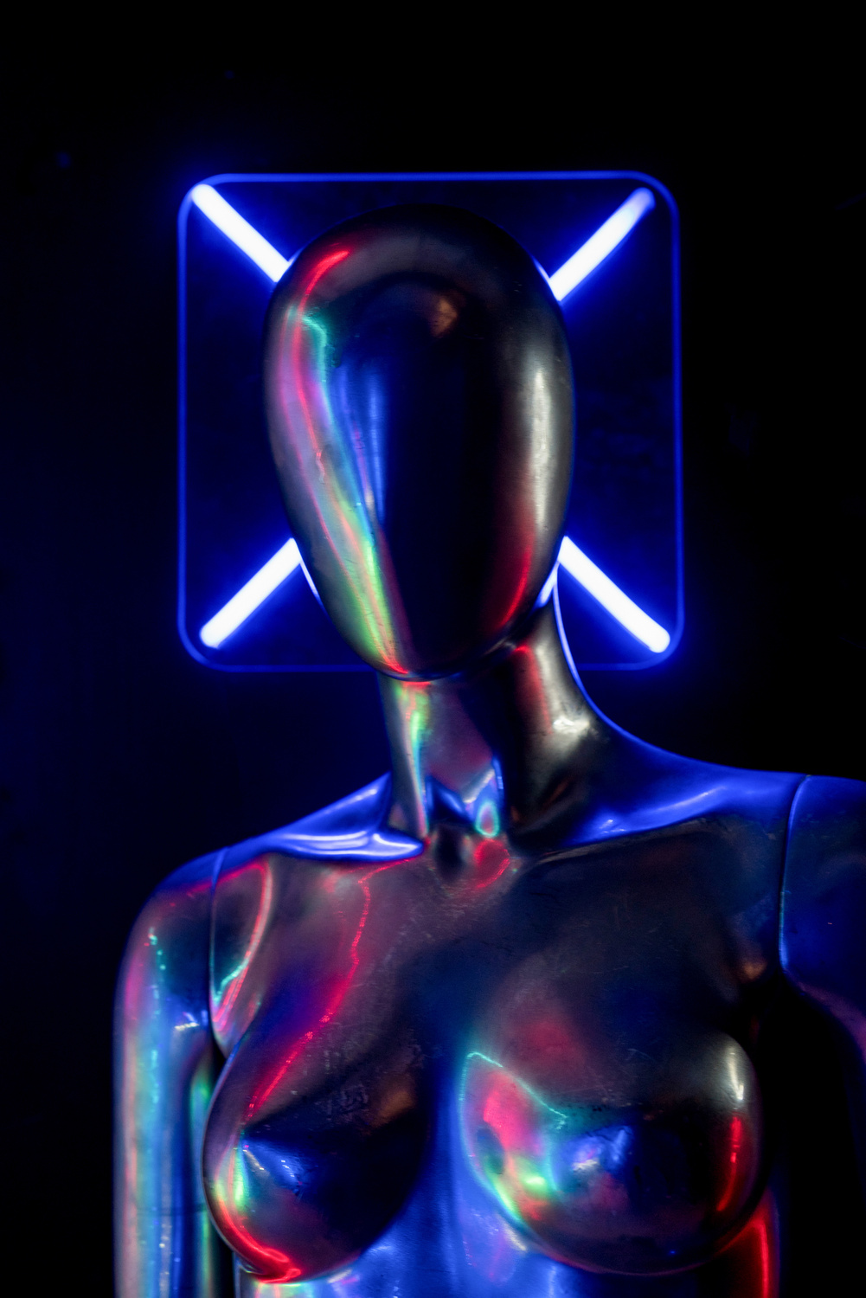
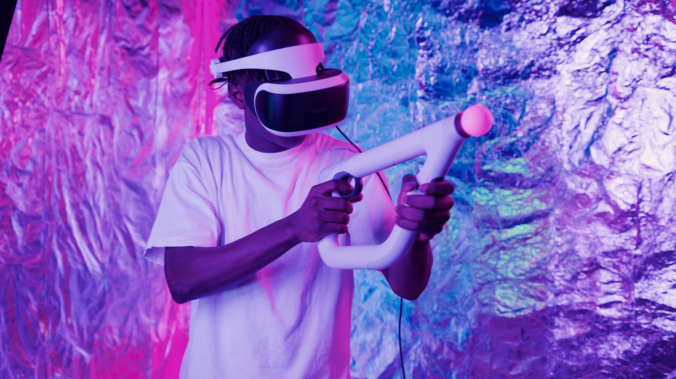

Team
Pedro Fernandes
Rachelle Beaudry
Sebastian Bennett
Founder
Designer
Developer
The heart and soul of the company. Also a person who comes up with an idea and then transforms it to real life.
The creative force behind businesses. Responsible for turning ideas into visually compelling works.
The brain behind businesses. Developer with 7 years of experience in the tech space.

Slide 3


CONTENT
01
The Unbelievable Power of Belief
02
Unleashing Your Inner Superpowers
03
Extraordinary Phenomena
04
The Science of Astonishment
05
The Transformative Impact of the Incredible on Human Existence

Slide 4


The Unbelievable Power of Belief
Beliefs shape reality When you believe something, you create a mindset that attracts experiences and outcomes that align with those beliefs

Slide 5
Unleashing Your Inner Superpowers
Ignite your potential and tap into the hidden strengths within you This transformational journey will empower you to: Unleash your true purpose Harness your unique talents Overcome challenges with resilience Shape your destiny with intention

Slide 6
Extraordinary Phenomena
Uncover the boundaries of the unknown as we delve into the captivating realm of extraordinary phenomena, where the inexplicable becomes a thrilling enigma

Slide 7
The Science of Astonishment
Explore the unfathomable depths of human perception and the neural mechanisms underlying amazement

Slide 8
The Transformative Impact of the Incredible on Human Existence
The incredible possesses an extraordinary ability to ignite our imagination and inspire us towards greatness It sparks wonder, curiosity, and a relentless pursuit of the unknown By embracing the incredible, we transcend our limitations and unlock the potential for profound personal growth and societal progress

Slide 9

@reallygreatsite
THANK YOU
hello@reallygreatsite.com
www.reallygreatsite.com
123 Anywhere ST., Any City, ST 12345

